Slide 1
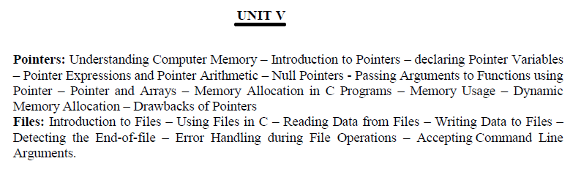

Slide 2
Pointer and Arrays in C
Arrays and pointers are synonymous in terms of how they use to access memory. But, the important difference between them is that, a pointer variable can take different addresses as value whereas, in case of array it is fixed. In C , name of the array always points to the first element of an array.

Slide 3
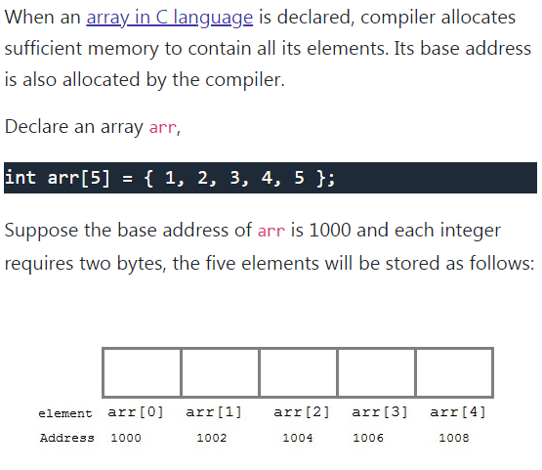

Slide 4
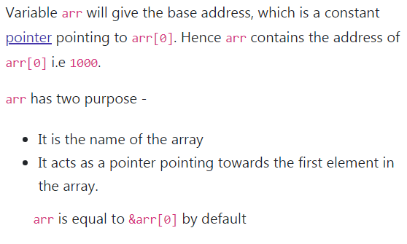

Slide 5
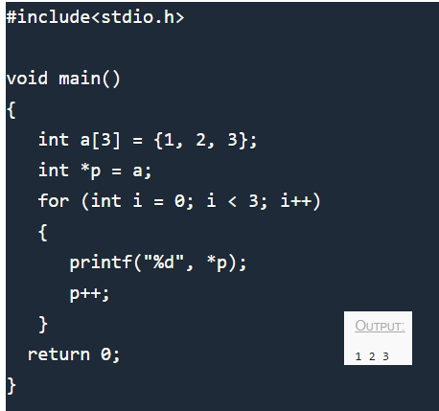
Pointer to Array
Use a pointer to an array, and then use that pointer to access the array elements.
For example,

Slide 6
